Slide 1
Deploy wordpress
BY DOCKER COMPOSE

Slide 2
AGENDA
What is Docker Compose?
3 Steps of Docker Compose
Building Blocks of Docker Compose
Docker Compose File Format
Installing Docker Compose
Examples - WordPress, Hello Whale etc.

Slide 3
What is docker compose ?
A tool for defining and running multi-container Docker applications
With Compose, weuse a YAML file to configure your application’s services
Compose works in all environments: production,staging, Development,Testing, as well as CI workflow
With single command,you create and start all the services form your configuration

Slide 4
3 step process of docker compose
Define your app’s environment with a Dockerfile.
Define the services that make up your app in docker compose file.
Run the CLI : $ docker-compose up -d

Slide 5
Docker compose file format :
Multi container application :
containers:
web:
build:
command:
python app.py
ports:- "5000:5000
volumes:
- ./code
environment:-
-PYTHONUNBUFFERED=1
redis:
image; redis:latest
command; redis-server - appendonly yes

Slide 6
Installing Docker compose
S curl -L https://github.com/docker/compose/releases/download/1.25.0/docker-compose
-Uname -s'- 'uname -m° -o /usr/local/bin/docker-compose
Schmod +x /usr/local/bin/docker-compose
Note: Docker Desktop will automatically install the latest version of Docker Engine for you

Slide 7
Sample WordPress file :
version: '3.7'
services:
db:
image: mysql:8.0.19
restart: always
volumes:
- db_data:/var/lib/mysql
restart: always
environment:
- MYSQL_ROOT_PASSWORD=wordpress
- MYSQL_DATABASE=wordpress
- MYSQL_USER=wordpress
- MYSQL_PASSWORD=wordpress
wordpress:
depends_on:
- db
image: wordpress:latest
ports:
- 80:80
restart: always
environment:
- WORDPRESS_DB_HOST=db
- WORDPRESS_DB_USER=wordpress
- WORDPRESS_DB_PASSWORD=wordpress
- WORDPRESS_DB_NAME=wordpress
volumes:
db_data:

Slide 8
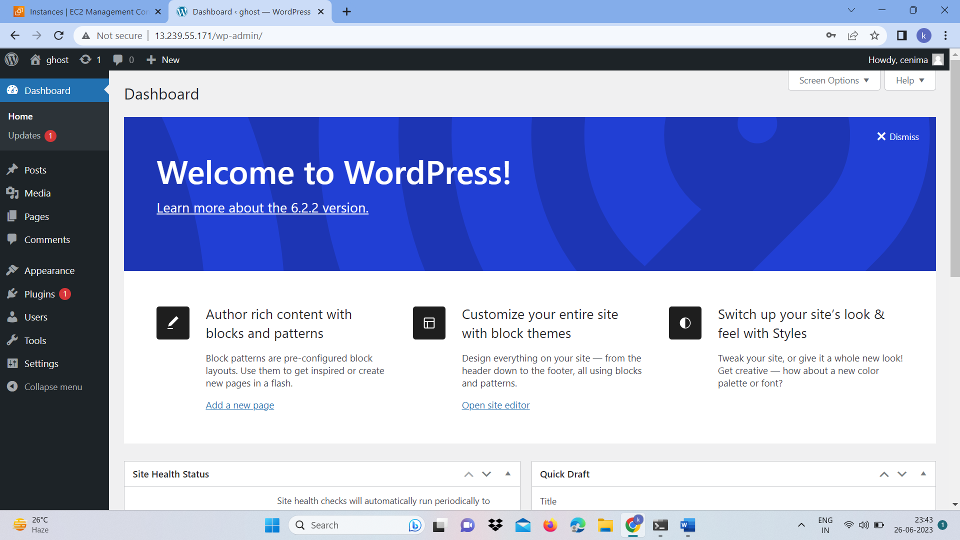
Wordpress output :

Slide 9
THANK YOU

